Slide 1
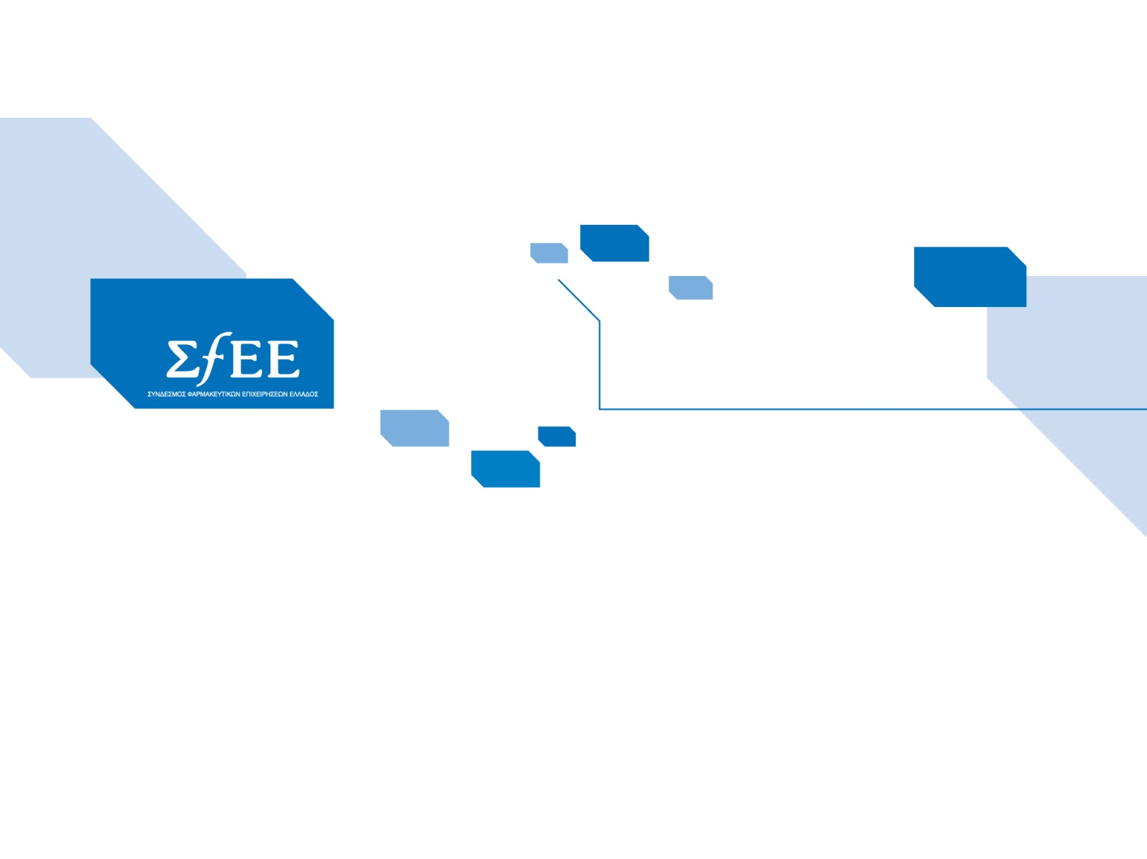
Maintaining patients’ access while proceeding with structural reforms September 19, 2013
Konstantinos M. Frouzis
SFEE President

Slide 2
Savings during the last 4 years reached €3,1 bn, spending halved
2014 target > €2,25 bn
GDP – Source, Eurostat 2011
2009, 2010, 2011, 2012 data OECD
* 2013,2014: 3rd MoU targets
€ bn
rebates & claw back
-0.9
-0.6
-1
-0.8
-0.7
% GDP | 2.2% | 1.9% | 1.8% | 1.5% | 1.3% | ~1%
GDP (bn) | €236 ($306) | €224 ($291) | €209 ($271) | €195 ($253) | €187 ($242) | €188 ($243)

Slide 3
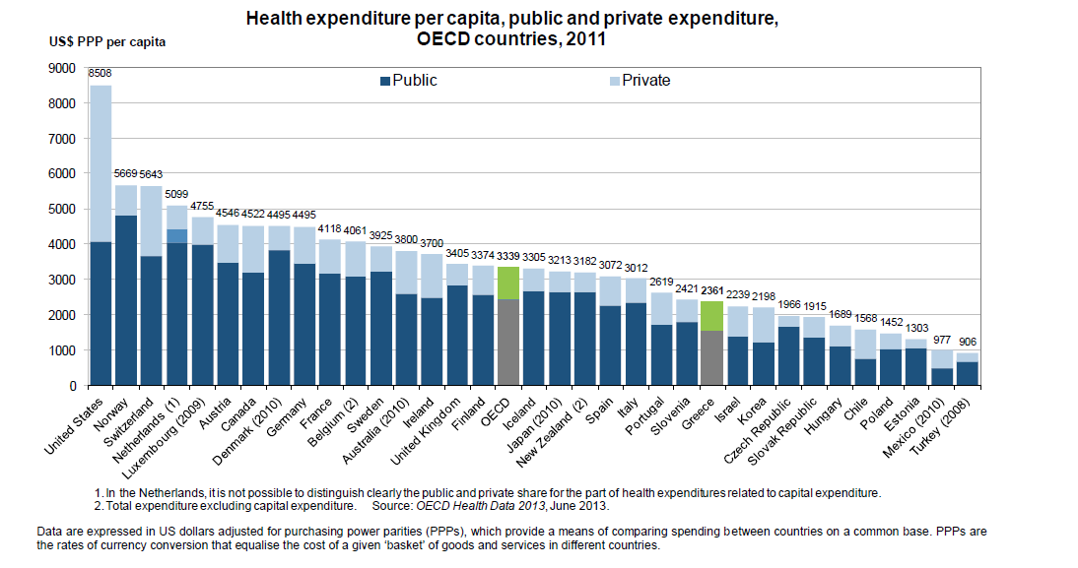
Health expenditure per capita, public and private expenditure, OECD countries, 2011
Total GR vs OECD : -30%
Public GR vs OECD : -40%

Slide 4
GR Public outpatient drug Expenditure/capita vs EU
2013 : EU avg 50% above GR 2014 : EU avg 80% above GR ??
UNREALISTIC TARGET
2014 target > €2,25 bn
€
Avg. EU: €320/capita (latest available data by OECD)
+50%
+80%
Source: ΙΟΒΕ/SfEE, Facts & Figures 2012

